Slide 1

Green Pace
Security Policy Presentation
Developer: Malik Spruill
A presentation on the Green Pace security policy guide to explain the coding and architectural issues as well as the applicability of standards and solutions that mitigate said issues.

Slide 2

OVERVIEW: DEFENSE IN DEPTH
The Green Pace security policy guide was developed to standardize and document best practices across a growing team, ensuring that every developer adheres to a consistent set of principles that address the evolving threat landscape and inherent vulnerabilities.
By integrating defense-in-depth measures such as threat matrices, external testing, encryption protocols, and more, the policy serves as a guide for identifying, mitigating, and preventing security risks in coding and system architecture.

Slide 3
THREATS MATRIX
Here is a Threats Matrix table populated with security risks mapped by its likelihood and priority metrics.
Likely Rules: Exception Handling (STD-009-EXC) Documentation (STD-011-DOC) | Priority Rules: Type Safety (STD-002-ABC) Value Safety (STD-DIV) String Manipulation (STD-005-STR) SQL Injections (STD-006-SQL) Memory Management (STD-007-MEM)
Low priority Rules: Assertions (STD-008-ASSERT) Hardcoded Values (STD-012-HCV) | Unlikely Rules: Loop Safety (STD-013-LOOP)

Slide 4
10 PRINCIPLES
10 Core Security Principles and Associated Coding Standards
1. Validate Input Data
Standards: STD-001, STD-002, STD-003
2. Heed Compiler Warnings
Standards: STD-001, STD-006
3. Architect and Design for Security Policies
Standards: All standards
4. Keep It Simple
Standards: STD-006, STD-007, STD-008
5. Default Deny
Standards: STD-004
6. Adhere to the Principle of Least Privilege
Standards: STD-004, STD-010
7. Sanitize Data Sent to Other Systems
Standards: STD-003, STD-004
8. Practice Defense in Depth
Standards: STD-005, STD-008, STD-009
9. Use Effective Quality Assurance Techniques
Standards: STD-007, STD-009
10. Secure Coding Standard
Standards: All Applicable

Slide 5
CODING STANDARDS
Immediate Priority (5):
STD-002-ABC: Ensure Proper Array Bounds Checking High Severity, Likely Occurrence, Medium Remediation cost
STD-004-DIV: Prevent Division by Zero Errors High Severity, Likely Occurrence, Medium Remediation cost
STD-005-STR: Ensure Proper String Handling High Severity, Likely Occurrence, Medium Remediation cost
STD-006-SQL: Use Parameterized Queries High Severity, Likely Occurrence, Medium Remediation cost
STD-007-MEM: Use Smart Pointers and Memory Deallocation techniques High Severity, Likely Occurrence, High Remediation cost
STD-012-HCV: Avoid Hardcoding Values Medium Severity, Medium Occurrence, Medium Remediation cost
High Priority (4):
N/A
Medium Priority (3):
STD-008-ASSERT: Use Explicit Error Handling alongside Assertions Medium Severity, Medium Occurrence, Low Remediation Cost
STD-009-EXC: Use Exceptions for Error Handling Medium Severity, Medium Occurrence, Medium Remediation Cost
STD-013-LOOP: Use Efficient Loop Constructs Medium Severity, Medium Occurrence, Low Remediation Cost
Low Priority (2):
STD-011-DOC: Document Code Concisely Low Severity, Medium Likelihood, Low Remediation Cost
Review Priority (1):
N/A
Priority Scale
Level | Description
5 | Immediate Action Needed
4 | High Priority Fix Required
3 | Medium Priority Fix Required
2 | Low Priority Fix Required
1 | Review and Remove or Schedule Fix
Vulnerability Ranking
Level | Description
Critical | System Compromised
High | Significant Security Impact
Medium | Moderate Security Impact
Low | Low Security Impact

Slide 6
ENCRYPTION POLICIES
At Rest
Involves encryption of stored data
Uses strong algorithms to protect against unauthorized users
Adheres to the principle of least privilege by ensuring only authorized users can decrypt sensitive data
In Flight
Secures data transmitted over networks using TLS/SSL
Prevents interception
Sanitizes data sent to other systems
In Use
Protects data by actively being processed in memory using techniques
Adds multiple levels of security

Slide 7
TRIPLE-A POLICIES
Authentication Policies
Password-based authentication where users provide a password to help identify who they are
Multi-Factor Authentication (MFA), which combines multiple credentials to enhance security
Public Key Infrastructure, which utilizes cryptographic keys to authenticate users, devices, etc
Authorization Policies
Role-Based Access Control (RBAC), which is an approach that assigns permissions to users based on their roles within an organization
Time-Based Restrictions, which are typically policies that limit access to certain resources during set timeframes
Accounting Policies
Session Monitoring, which involves recording details of user sessions such as login times
Billing and Cost Allocation, which is centered around collecting data on resource usage, facilitating cost distribution for a company
Compliance Reporting, which involves generating reports to demonstrate following of policies, regulations, and etc

Slide 8
Unit Testing
We’ll be showcasing four tests, consisting of positive and negative tests for Data Type Testing for the next four slides.

Slide 9
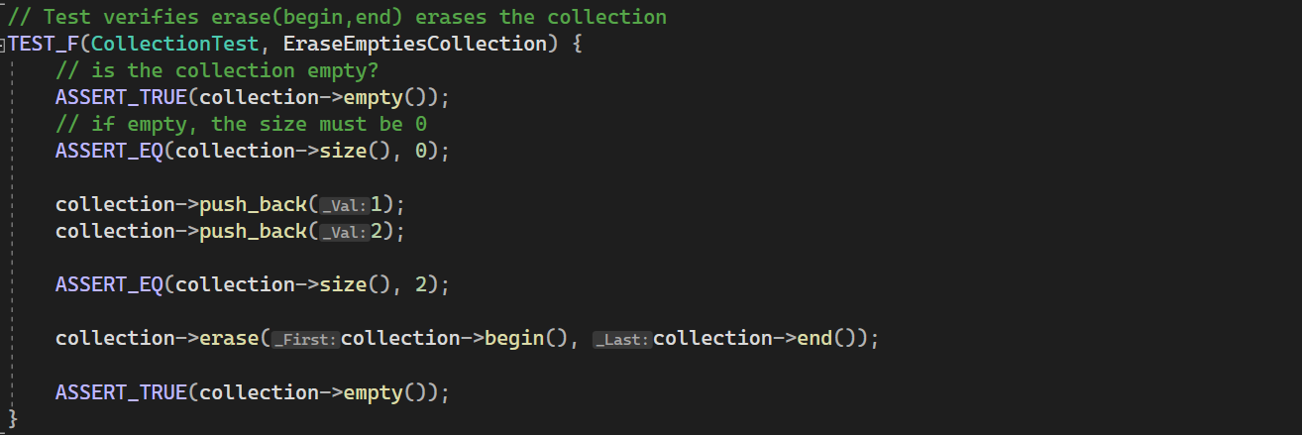
Does the vector collection erase elements expectedly?

Slide 10
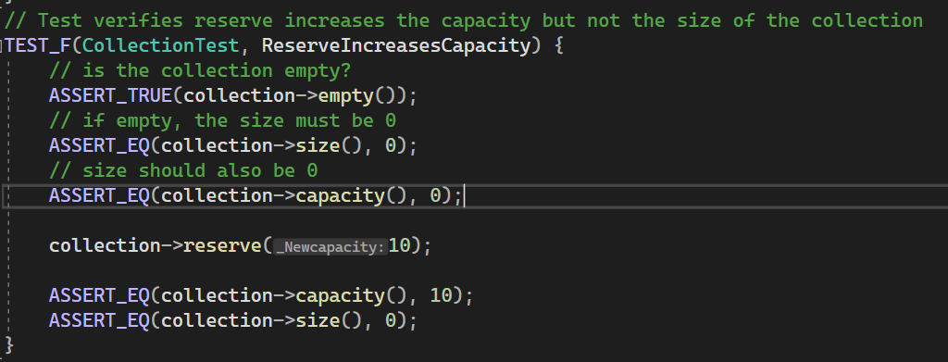
Does the vector collection reserve method increase only the capacity and not the size?

Slide 11
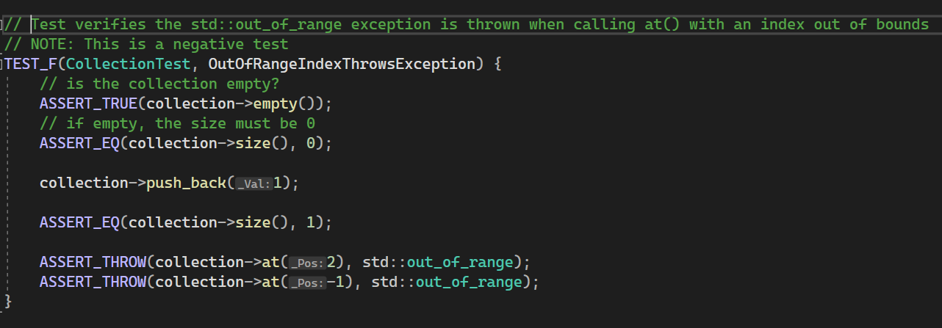
Does the vector collection at method correctly throw an out of range exception?

Slide 12
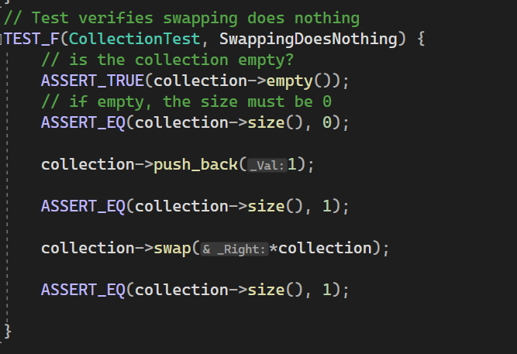
Does the vector collection swap method prevent an error swap?

Slide 13

AUTOMATION SUMMARY

Slide 14
TOOLS
DevSecOps Pipeline Summary
<Pre-Production>
Assess and Plan: - OWASP: Code Scanning, Vulnerabilities - SonarQube: Code Scanning, Coverage, Vulnerabilities
Design:
- OWASP: Code Scanning, Vulnerabilities
Build:
- Jenkins: Build Automation
Verify and Test: - Valgrind: Debugging and Testing Tool
<Production>
Monitoring: - Slack: Communications Platform, Alerts
Intrusion Detection: - Snort: Detection, Breaches, Alerts
Incident Response: - Splunk: Real-time monitoring, detection and response
Maintain and Stabilize: - Patching, audits, recovery

Slide 15
RISKS AND BENEFITS
GAPS
Lack of SQL injection detection
Inconsistent memory allocation policies
Unsafe String Operations
Solutions
Implement prepared statements, enforce input validation and use Object-Relational Mappers for risk mitigation
Use smart pointers and enable memory leak detection tools
Safe string handling functions, bounds checking, immutable string objects
Risks of Delay
Security risks such as SQL-based attacks and unpredictable crashes
Legal costs and maintenance expenses as well as downtime
Operational risks such as slower queries and troubleshooting slowing development
Problems
SQL Injection (STD-006-SQL) – user input is improperly sanitized, susceptible to database attacks
Memory Management Issues (STD-007-MEM) – Poor allocation and deallocation of memory, leading to leaks, dangling data, buffer overflows, and more
Improper String Handling (STD-005-STR) – Unsafe string operations, which cause buffer overflows, data corruption and more
Benefits of Immediate Action
Security Enhancements
Cost-Efficiency
Operational Improvements like System Performance and Query Execution Speeds

Slide 16
RECOMMENDATIONS
Compliance Audits
- Lack of scheduled audits with external, licensed auditors - Comply with industry-standard auditing processes to ensure scheduled audits
Training and Awareness
- No form of training currently exists - Initiating training programs and security and security onboarding would solve this issue
Cloud Security
- Considering Triple-A’s Authorization Principle, there aren’t any explicit standards for access implementations in place yet - Creating access roles and verifying the necessity of those roles semi-annually, this would resolve this issue
Security Testing Coverage
- There is a lack of testing such as integration testing, load testing, and penetration testing - Adding more testing variability such as the ones mentioned above, this would solve this issue

Slide 17
CONCLUSIONS
Secure Development Practices: - Addressing OWASP security risks Proactive Security Testing:
- Continuous automated vulnerability assessments
Zero Trust Security Framework:
- Apply the principle of least privilege - Enforce access control
Cloud Infrastructure Protection (CSA Compliance):
- Encryption techniques to protect data - Secure cloud infrastructure with consideration of best-practices
Advanced Authentication Mechanisms:
- MFA mandates - Session Management
Comprehensive Threat Detection and Incident Management:
-Audit logs - Threat intelligence
Security Awareness and Training and Education:
Cybersecurity trainings
Skill evaluation assessments

Slide 18
REFERENCES
Spruill, M. (2025). Green Pace Developer: Security Policy Guide Template
[Unpublished class paper]. Southern New Hampshire University.

